Slide 1
Using Medical Necessity to Improve Client Outcomes
Jason Hess, LCAC
Executive Director
Heartland RADAC

Slide 2
Alternative Title
How do I get those darned insurance companies to listen?!?

Slide 3
4 Essential Elements to Good Counseling
WEG +
Warmth – Caring, Supportive, Welcoming
Empathy – Understanding, Responsiveness
Genuineness – Heartfelt, Sincere, Natural
The ability to tell everything you know about your client to a complete stranger who has never seen and never will see them in a clear, consistent manner using absolutely no jargon whatsoever while insuring there is a complete plan for the whole person that includes how they will manage their medical, mental health, housing, and employment issues all the while believing that the other person has no interest in the wellbeing of the person you are looking at across your desk

Slide 4
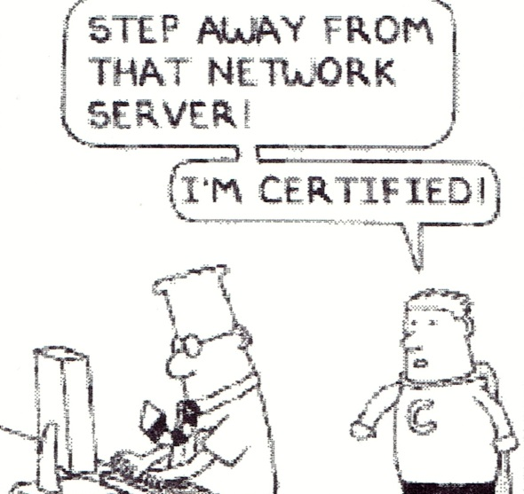
What we all learned in school

Slide 5
What is our work???
Understanding Systems and Recovery Oriented Systems of Care (ROSC)
Helping people accomplish their goals
Bridging
Teaching
Not Assuming ANYTHING!!!

Slide 6
“As for the future, your task is not to foresee it, but to enable it.”
Antoine de Saint Exupery

Slide 7
What is Medical Necessity
Medicare defines it as:
Services or supplies that are needed for the diagnosis or treatment of your medical condition and meet accepted standards of medical practice

Slide 8
What is Medical Necessity
A general definition of medical necessity is:
Services requested are needed to identify or treat an illness that has been diagnosed or suspected.
Treatment services are consistent with:
the diagnosis and treatment of the condition (‘experimental treatments’ are disallowed)
the standards of good medical practice
Treatment services required are for other than convenience.
Public Policy Statement on Managed Care, Addiction Medicine and Parity: Supplement for Physicians and Others on the Step-by-step Utilization Review Process

Slide 9
Why do we need to consider Medical Necessity
Defines observed conditions and problems
Determines level of treatment need
Provides a method of communication between service providers
Gives information to Managed Care Organizations for Utilization review
IT ALLOWS TREATING PROVIDERS TO GET PAID!!!

Slide 10
How is Medical Necessity Determined?
Medical necessity starts with a solid assessment of an individual’s need and applying it to specific criteria designed to guide an individual into the most clinically appropriate level of care.

Slide 11
When do we need to think about Medical Necessity?
All the time!!!

Slide 12
Assessment
Observation of behaviors
Clinical Interview
Collateral information
Secondary Testing
Diagnosis

Slide 13
Assessment is an ongoing process that is PART of treatment, not simply an activity that determines treatment.
P
l
a
c
e
m
e
n
t
Assessment Variables
Client Preference
Diagnosis
Course of Illness
Prior Treatment Response
Family History
Mental Status
Matching Variables
Intoxication/Withdrawal
Biomedical Conditions
Emotional/Behavioral Conditions
Change Readiness
Relapse Potential
Environmental Conditions
Modifying Variables
Age
Gender
Sexual Orientation
Culture/Language/Ethnicity
Service Availability
Childcare / Eldercare

Slide 14
Secondary Assessment Tools - Examples
SASSI - Substance Abuse Subtle Screening Inventory
Paper/Pencil
Spanish Version
Cost
AUDIT – Alcohol Use Disorders Identification Test
Oral or paper/Pencil
Multiple Languages
Public Domain
CAGE-AID
Oral or paper/pencil
Multiple Languages
Public Domain

Slide 15
Secondary Assessment Tools – Cont.
DAST – Drug Abuse Screening Test
Oral or paper/pencil
Reproduce with author credit
CRAFFT
Adolescents
Oral or paper/pencil
Public Domain
MAST – Michigan Alcoholism Screening Test
Oral or paper/pencil
Public Domain

Slide 16
Secondary Assessment Tools – Resource
For additional information specific to substance use (and other) assessment tools:
http://lib.adai.washington.edu/instruments

Slide 17
Recognized Criteria - Kansas
Kansas recognizes and mandates the use of the Patient Placement Criteria published by the American Society of Addiction Medicine for the following populations:
Those eligible for Federal Block Grant funding
Medicaid recipients
DUI Evaluations

Slide 18
ASAM Patient Placement Criteria Guides Assessment across 6 Dimensions
Acute Intoxication and/or Withdrawal – Assesses the need for stabilization of acute intoxication.
Biomedical Conditions & Complications – Assesses the need for physical health services
Emotional, Behavioral, or Cognitive Conditions & Complications – Assesses the need for mental health services.
Readiness to Change – Assesses the degree of need for motivational enhancement services to engage a person and begin a recovery process.
Relapse, Continued Use, or Continued Problem Potential – Assesses the need for relapse prevention services.
Recovery/Living Environment – Assesses the need for specific individualized family or significant other support and services.
Source: Mee-Lee D, Shulman GD, Fishman MJ, Gastfriend DR, Miller MM, eds. The ASAM Criteria: Treatment for
Addictive, Substance-Related, and Co-Occurring Conditions. 3rd ed. Carson City, NV: The Change Companies; 2013.

Slide 19
Using Criteria to Assess Need
Criteria Are Not …
Criteria Are …
a cookbook or checklist
a substitute for clinical judgement
a determination of length of stay
a way to just start a client in treatment
a method of communication to engage people into treatment and the recovery process
a way to communicate with a client about next steps in their care
a guide to look at an individual’s situation in a holistic manner
a guide to assist a client in moving through the continuum of care
a way to communicate with payer sources about the needs of their members

Slide 20
Documenting Medical Necessity
Key Components of Documentation:
Multi-Dimensional – Assess across all parts of an individual’s life.
Clear documentation related to the presenting problem.
Answer the phrase “As evidenced by . . . “
Specify the intended interventions and/or referrals

Slide 21
“As Evidenced By…”

Slide 22
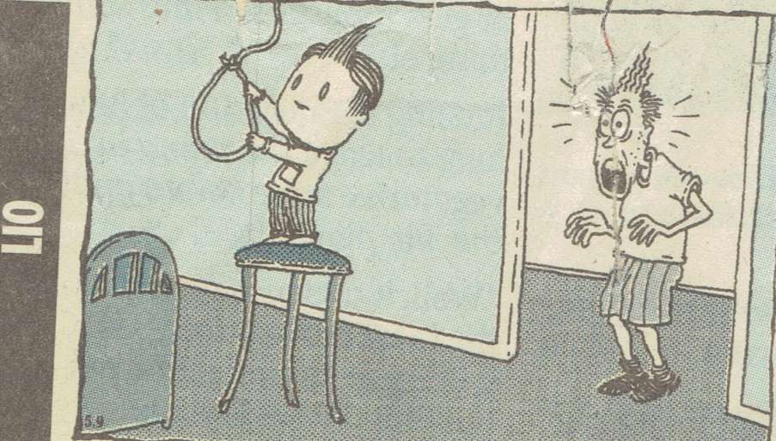
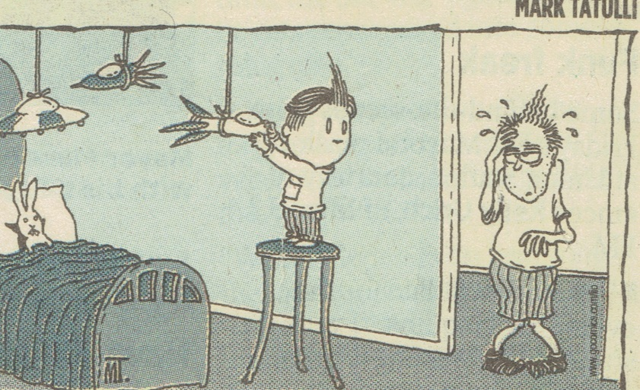

Slide 23
Continuum of Care
Network of Treatment Services
Network of Treatment Providers
Meets individual’s changing needs
Includes clinical and non-clinical modalities
Recovery Oriented Systems of Care (ROSC)

Slide 24
Levels of Care Kansas currently licenses treatment programs to provide the following modalities of care:
Assessment and Referral
Level 0.5 – Early Intervention
At-Risk Individuals who do not meet diagnostic criteria for substance use disorder
Level 1 – Outpatient
Less than 9 hours of service per week
Level 2.1 – Intensive Outpatient
9 hours or more of service per week

Slide 25
Levels of Care – Cont.
Level 3.1 – Reintegration
24 hour structure with at least 3 hours per week of alcohol and drug specific counseling
Level 3.3 (Adult) & 3.5 (Adolescent) – Intermediate
24-hour residential care
Level 3.2-WM – Social Detox
Withdrawal Management in a 24-hour support setting

Slide 26
Moving through the treatment Continuum
Should Not…
Should…
Be based on time spent in treatment
Depend on the number of goals completed
Be determined without input from the client
Be made by a non-clinical system
Include input from the client
Depend on the client’s ongoing need through multidimensional assessment
Match a client’s specific needs
Provide service at the least restrictive level of care that is safe

Slide 27
HELP!!! What should I write down so a Care Manager (or anyone else for that matter) will understand my client’s needs?!?!
Remember . . .
You are painting a picture of an individual’s need
You are communicating with someone who will neither see nor speak to the client about whom you are referring – DON’T ASSUME ANYTHING
Be specific, present observable behaviors and quotations
Complete the phrase “As Evidenced By . . . “
Include a multidimensional assessment
Specify the medically/clinically necessary service types
What goals will the client be working toward achieving?

Slide 28
Service/Treatment/Recovery Planning
“If you don't know where you are going, you'll end up someplace else.”
Yogi Berra

Slide 29
SMART Treatment Planning
Specific – What exactly is the outcome I will achieve?
Measurable – How will I know when I’ve achieved this goal?
Achievable – Is my goal realistic? Can it be accomplished?
Relevant – Will the goal help me achieve what I ultimately want?
Time limited – When can I expect to have achieved this goal?

Slide 30
Client Driven
What does the client want to accomplish?
Written in client’s words
Clinical guidance is necessary to connect desires/wants to the problem being addressed.
Celebrate accomplishments and create the opportunity for new achievements.
Plan should result in an inventory of achievements

Slide 31
Discharge/Transition Planning
Answers the question “If services were not available to you after today what needs to be in place so you can make change?”
Begins at Admission
Identifies the Recovery Oriented Systems of Care (ROSC)
Plans for community based recovery

Slide 32
The End

